Slide 1
Chapter 3
Data Conversion
4.<number>

Slide 2
OBJECTIVES
Investigate the principles of different methods for Data Conversion
4.<number>

Slide 3
FOUR TYPES OF DATA CONVERSION
1. Digital to Digital Conversion
2. Analog to Digital Conversion
3. Digital to Analog Conversion
4. Analog to Analog Conversion
4.<number>

Slide 4
3-1 DIGITAL-TO-DIGITAL CONVERSION
In this section, we see how we can represent digital data by using digital signals.
The conversion involves three techniques:
line coding, block coding, and scrambling.
Line coding is always needed; block coding and scrambling may or may not be needed.
4.<number>

Slide 5

Note
Line coding is the process of converting digital data to digital signals
4.<number>

Slide 6

Figure 3.1 Line coding and decoding
4.<number>

Slide 7
SOME CONCEPTS
- Data element
Signal element
Data rate
Signal rate
4.<number>

Slide 8
Note
Data element: A smallest entity that can present a piece of information
Signal Element: The shortest unit (timewise) of digital signals
4.<number>

Slide 9
Note
We define a ratio r which is the number of data elements carried by each signal element
4.<number>

Slide 10

Figure 3.2 Signal element versus data element
4.<number>

Slide 11
Note
Data rate: defines the number of data elements (bits) sent in 1 second.
The unit is bits per second (bps)
4.<number>

Slide 12
Note
The signal rate is the number of signal elements sent in 1s (baud rate)
_{S = N*(1/r) baud}
4.<number>

Slide 13
Example 3.1
A signal is carrying data in which one data element is encoded as two signal element ( r = 1/2). If the bit rate is 100 kbps, what is the baud rate?
Solution
4.<number>

Slide 14
Example 3.1
Solution
The baud rate is: S=N*1/r=100/(1/2)=200 Kbaud
4.<number>

Slide 15

Figure 3.3 Line coding categories
4.<number>

Slide 16
WAYS TO EVALUTATE
LINE CODING TECHNIQUES
Signal spectrum
Synchronization
Cost and complexity
4.<number>

Slide 17
Note
Signal Spectrum: A signal that does not a direct-current component is a good signal.
4.<number>

Slide 18
Note
DC Components: When the voltage level in a digital signal is constant for a while, the spectrum creates very low frequencies (results of Fourier analysis). These frequencies around zero, called DC (direct-current) components
4.<number>

Slide 19
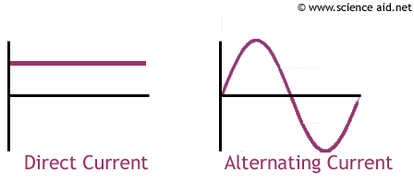
Figure 3.4 Example of a signal having dc component
4.<number>

Slide 20
Note
_{Synchronization:}
The signal can be self synchronized If there are transitions at the beginning, middle or the end of the pulse.
4.<number>

Slide 21

Figure 3.5 Effect of lack of synchronization
4.<number>

Slide 22
Note
_{Cost and Complexity:}
The higher signal rate to achieve a given data rate, the greater the cost.
4.<number>

Slide 23
Note
Next: We will examine different line coding to answer the questions:
_{How does it work?}
_{Is it has dc components?}
_{Can it be self-synchronized}
How is the complexity and the cost?
4.<number>

Slide 24

Figure 3.6 Unipolar NRZ scheme
4.<number>

Slide 25

Figure 3.7 Polar NRZ-L and NRZ-I schemes
4.<number>

Slide 26
Note
In NRZ-L the level of the voltage determines the value of the bit.
In NRZ-I the inversion or the lack of inversion determines the value of the bit.
4.<number>

Slide 27
Note
NRZ-L and NRZ-I both have a DC component problem.
4.<number>

Slide 28

Figure 3.8 Polar RZ scheme
4.<number>

Slide 29

Figure 3.9 Polar biphase: Manchester and differential Manchester schemes
4.<number>

Slide 30
Note
In Manchester and differential Manchester encoding, the transition
at the middle of the bit is used for synchronization.
4.<number>

Slide 31
Note
The minimum bandwidth of Manchester and differential Manchester is 2 times that of NRZ.
4.<number>

Slide 32
Note
In bipolar encoding, we use three levels: positive, zero, and negative.
4.<number>

Slide 33

Figure 3.10 Bipolar schemes: AMI (Alternative Mark Inversion)
and pseudoternary
4.<number>

Slide 34
WHERE ARE THEY USED?
NRZs: not used in long-distance communication, used for digital magnetic recording only and RS232, USB.
Manchester: IEEE 802.3 (Ethernet) standard
for baseband coaxial cable and twisted-pair bus LANs.
Differential Manchester: IEEE 802.5 token ring LAN, using shielded twisted pair
AMI and Pseudoternary: the line coding system used with 100-base-T Ethernet
4.<number>

Slide 35
Note
In mBnL schemes, a pattern of m data elements is encoded as a pattern of n signal elements in which 2^{m} ≤ L^{n}.
4.<number>

Slide 36

Figure 3.11 Multilevel: 2B1Q scheme
4.<number>

Slide 37

Figure 3.12 Multilevel: 8B6T scheme
4.<number>

Slide 38

Figure 3.13 Multilevel: 4D-PAM5 scheme
4.<number>

Slide 39

Figure 3.14 Multitransition: MLT-3 scheme
4.<number>

Slide 40


Table 3.1 Summary of line coding schemes
4.<number>

Slide 41
Note
Block coding is normally referred to as mB/nB coding;
it replaces each m-bit group with an
n-bit group.
4.<number>

Slide 42

Figure 3.15 Block coding concept
4.<number>

Slide 43

Figure 3.16 Using block coding 4B/5B with NRZ-I line coding scheme
4.<number>

Slide 44
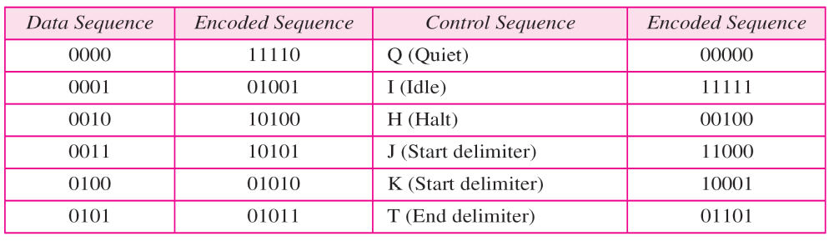

Table 3.2 4B/5B mapping codes
4.<number>

Slide 45

Figure 3.17 Substitution in 4B/5B block coding
4.<number>

Slide 46
Note
Scrambling: substitutes long zero-level pulses (in AMI) with a combination of other levels to provide synchronization
4.<number>

Slide 47

Figure 3.18 AMI used with scrambling
4.<number>

Slide 48

Figure 3.19 Two cases of B8ZS scrambling technique
4.<number>

Slide 49
Note
B8ZS substitutes eight consecutive zeros with 000VB0VB.
4.<number>

Slide 50

Figure 3.20 Different situations in HDB3 scrambling technique
4.<number>

Slide 51
Note
HDB3 substitutes four consecutive zeros with 000V or B00V depending
on the number of nonzero pulses after the last substitution.
4.<number>

Slide 52
3-2 ANALOG-TO-DIGITAL CONVERSION
We have seen in Chapter 2 that a digital signal is superior to an analog signal. The tendency today is to change an analog signal to digital data. In this section we describe two techniques, pulse code modulation and delta modulation.
Topics discussed in this section:
Pulse Code Modulation (PCM)
Delta Modulation (DM)
4.<number>

Slide 53

Figure 3.21 Components of PCM encoder
4.<number>

Slide 54

Figure 3.22 Three different sampling methods for PCM
4.<number>

Slide 55
Note
According to the Nyquist theorem, the sampling rate must be
at least 2 times the highest frequency contained in the signal.
4.<number>

Slide 56

Figure 3.23 Quantization and encoding of a sampled signal
4.<number>

Slide 57
3-3 TRANSMISSION MODES
The transmission of binary data across a link can be accomplished in either parallel or serial mode. In parallel mode, multiple bits are sent with each clock tick. In serial mode, 1 bit is sent with each clock tick. While there is only one way to send parallel data, there are three subclasses of serial transmission: asynchronous, synchronous, and isochronous.
Topics discussed in this section:
Parallel Transmission
Serial Transmission
4.<number>

Slide 58

Figure 3.27 Data transmission and modes
4.<number>

Slide 59

Figure 2.28 Parallel transmission
4.<number>

Slide 60

Figure 3.29 Serial transmission
4.<number>

Slide 61
Note
In asynchronous transmission, we send 1 start bit (0) at the beginning and 1 or more stop bits (1s) at the end of each byte. There may be a gap between
each byte.
4.<number>

Slide 62
Note
Asynchronous here means “asynchronous at the byte level,”
but the bits are still synchronized;
their durations are the same.
4.<number>

Slide 63

Figure 3.30 Asynchronous transmission
4.<number>

Slide 64
Note
In synchronous transmission, we send bits one after another without start or stop bits or gaps. It is the responsibility of the receiver to group the bits.
4.<number>

Slide 65

Figure 3.31 Synchronous transmission
4.<number>

